Slide 1
Searching for Success
Using google searches to predict the stock market

Slide 2
Background
Every fiscal quarter, every public company releases their quarterly earnings to the public
These are generally the most significant events for a company’s share price
Amateur investors are competing against complex algorithms and professional day traders who follow the market religiously, making gaining an edge in the market very difficult
If an investor can predict a company’s quarterly performance before the release of the earnings, the investor can invest accordingly and potentially realize significant returns
Google Search volume for certain keywords could show if a certain company is enjoying a better quarter than usual

Slide 3
Use Case
An amateur investor can use our tool to visualize search trends for the keywords that our model has identified as indicators.
Visualize the performance of the stock relative to the S&P 500
Depending on the search volume of relevant keywords, our model will give a probability that the stock price will increase when the quarterly reports will be released
EG Ouput : 0.65. Interpreted as the 65% chance the stock performance increases.
Note: No prediction of the stock price iteself

Slide 4
Data Used
Stock Price Data – Quandl
Python package that allows access to high quality financial and economic datasets
WIKI End Of Day Stock prices (Free)
Public Domain data for 3000 companies/ 40 years
Well structured and clean
Google Trend Index - Pytrends
Unofficial Python package that shows Google trends
Difficult to get daily search trends
Only relative search data amongst only 5 keywords

Slide 5
Design
Main Functions
Date Finder – Calculates the Expected date for the selected company
Plot – Displays graphs for the stock performance and selected keywords trends over 5 years
ML Model – Uses LASSO regression to identify the keywords that have the highest impact on the stock price, and then we used Logistic Regression with the identified keywords to calculate the likelihood of stock price change

Slide 6
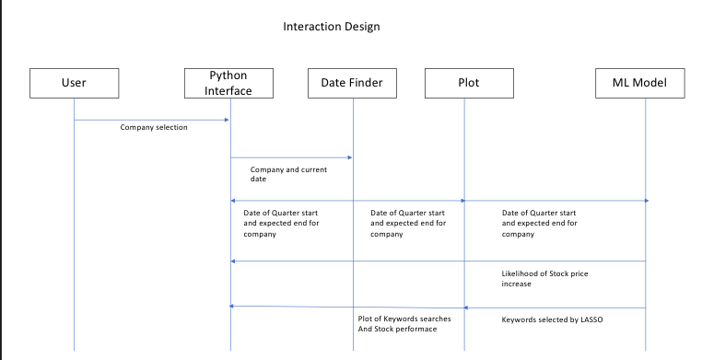
Project Structure

Slide 7
Output- Earning Report Date (Amazon)
Calculates the Expected date for the selected company.
Current Quarter Date: 04-01-2017 to 06-30-2017
The current fiscal quarter ends on June 30, 2017.
The next earnings report from AMZN is expected: July 25, 2017 - July 30, 2017.

Slide 8
Output– Stock Performance Prediction Model (Amazon)
UseLASSO regression to identify the keywords that have the highest impact on the stock price
Potential Keywords List for Amazon: Amazon Australia,Amazon dvd,Amazon mp3,Amazon books,Amazon India,Amazon music,Amazon UK,Amazon video,Amazon error,Amazon kindle,Amazon order,Amazon recall,Amazon register,Amazon sucks,Amazon echo]
Keywords selecgted by ML Model: Amazon Kindle, Amazon Order, Amazon Recall, Amazon Sucks, Amazon Echo, Amazon dvd
Logistic Regression with the identified keywords to calculate the likelihood of stock price change.
Predicted probability the stock price will increase after releasing next quarter’s earnings report: 0.92

Slide 9
Output– Historical Data Plot (Amazon)
Graphs for the stock performance and selected keywords trends over 5 years

Slide 10
Demo

Slide 11
Lessons Learned
Define Project scope as early as possible

